Slide 1
Spot Check
What specific elements of the Adventists diet promote good health?
Which disease risks tend to be lower for Adventists?
How is the “power” downshift specifically promoted in their religion?
What elements for longevity are the same for the those in longevity and each of the previous Blue Zones? What things are unique to this Blue Zone?
How does personal responsibility toward health help Adventists avoid the trappings of processed food, the food industry and obesity?

Slide 2
Hyperlinks
You will find links to videos etc. on slides 5, 9, 15 and 19. Please make sure to open those by viewing in powerpoint download presentation mode.

Slide 3
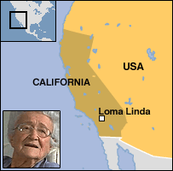
The Power of Spirituality
Notes:
The US Blue Zone. In spite of what most thinks, it is possible here.

Slide 4
Adventists
Healthy Outcomes
Lower cancer risks
Lower risk of heart disease
Lower risk diabetes
Notes:
The incidence of life threatening and shortening chronic diseases is less and occurs later in life. These same chronic diseases are the top three causes of death in the US

Slide 5
Demographics
23,600 total, about half are Seventh-day Adventists, the longest-lived people in America.
Loma Linda University Medical School graduates one of the highest percentages of registered dieticians and nutritionists in the country.
Click on the Video to learn more
Video
Notes:
The university supports the focus on nutrition as a preventative measure. Check out the video

Slide 6
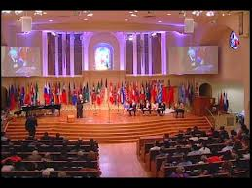
Religious Focus - Health
Notes:
Maintaining good health through a structured diet, physical activity, are hallmarks of their religious belief.

Slide 7
30 yr old Adventists Life Expectancy
Male 7.3 longer
Female 4.4 longer
Vegetarian (9.5; 6.1)
Notes:
Through their good health habits they achieve longer and healthier years than most Americans

Slide 8
Guidelines
Eat nuts
Nurture mind and body
Help Others
Tight social networks
Decompress
Volunteer
Eat a light dinner
Notes:
Each of these strategies plus a plant based diet are key to their good health

Slide 9

5-6 per day
Notes:
How many glasses of water do you drink each day? Water makes up most of our body weight and is essential for optimal brain and system functioning. Often when we feel hungry or fatigued we are actually dehydrated. Sipping on water throughout the day helps us to maintain optimal hydration.

Slide 10

Downshifting
Reduce stress and have a better work-life balance.
Change to a more fulfilling career away from a job that holds no interest
and only provides stress.
Have more time to spend with family and friends, to enjoy hobbies and follow interests.
Improve health by spending more time exercising, or another activity that reduces stress levels and increases fitness. Also includes cooking from scratch instead of eating packaged meals or take-away.
Reduce spending and clutter, reducing the emotional overhead of having too much stuff, spending too much and feeling pressured to work long hours.
Support the local community by volunteering, or buying locally, or participating in local activities instead of travelling.
Help the environment by reducing consumption.
"He who dies with the most (money, toys, handbags, ... ) , dies” Ted talk
Notes:
Which of these would motivate you most? See Ted talk How can you recreate your life to balanced approach to your life, both now and in the future. How do the religious beliefs of the Adventist support work life balance (in all aspects of life)?

Slide 11

What downshifting isn't
Downshifting doesn't mean suddenly giving up your job and moving to your own farm but…
It doesn't mean selling or getting rid of all your possessions but…
It doesn't mean changing careers and working for non-profit organizations but…
It doesn't mean you will never travel nor buy new things ever again but…
It is not an escape - it is a search for….
Notes:
When you are “downshifting” you are not a slacker, but are recharging and focusing on the things that matter. It also represents a balance between work and life.

Slide 12

Downshifting
Reduce - Balance
  work hours
  income, often as a result of reducing work hours.
  spending and consumption levels, responsibilities or change career, to reduce stress and work in an environment that matches their personal values.
Reach -Connect
  out to their family and friends
  local community, seeking a sense of fulfillment and happiness.
Notes:
The adage expressing “keeping up with the Jones’s” has helped create the mindset of the current American way of life. We are suppose to work more to have more and want more so that we have to work more. It is a vicious cycle. Finding the optimal balance that creates success in career, family and community is key. This is why Adventists take Saturday’s away from work and come together to volunteer, learn and share.

Slide 13
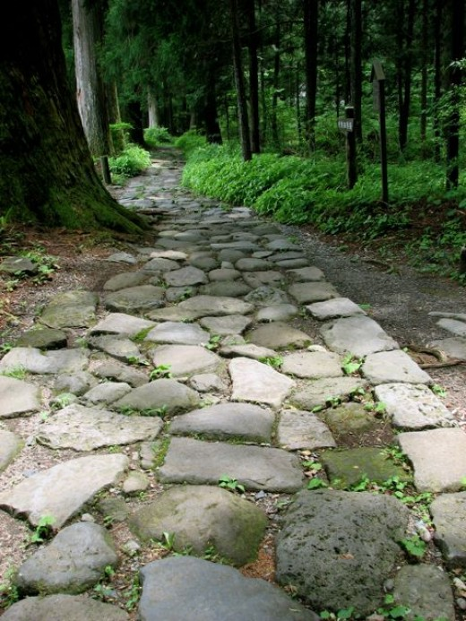
Your Ideal Day
What, realistically speaking, does it look like?
Who would share it with?
What would be your work/life balance?
How can you change your present life to move closer to your ideal life?
Looking forward, how can you create a life that includes components of your ideal day.?
Notes:
Take a few minutes to reflect on these questions.

Slide 14


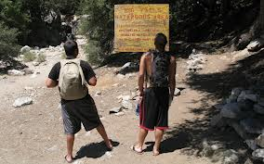
Healthy environment
Notes:
Loma Linda supports good health practices through environmental changes and access. What does your community do to support good health? Does your community support or detract from your health?

Slide 15

Habits to Avoid
Alcohol
Smoking
Unhealthy eating
V
Notes:
Take a look at he video to see how Loma Linda confronted the fast food challenge.

Slide 16
Fast Food Fight
To avoid a fate of obesity and shortened lifespan many are:
  Determined to avoid that fate in Loma Linda. Dr. Wellhausen led a fight to keep McDonald’s out of the community.
  Another restaurateur, Mike Samaan accommodates as does Demiana Deli that offers salads, pasta and other non-meat dishes.
  What are your thoughts? Legislating Health?
Notes:
Other cities have tried to legislate good health practices by reducing size of sodas and changing vending machines. What do you think? Should government get involved in the free choice of their citizens. This is very controversial. If you respond to this question make sure that you see how this type of legislation has worked or not worked in the past.

Slide 17

Defying Disparities
Although in the general population blacks show poorer quality of life on a variety of measures, our results show that black Adventists have a significantly better quality of life than the average American," said Dr. Jerry Lee, principal investigator for ARHS.
Notes:
This is very important. Public health confronts the issue of disparities through programs and access to healthcare. In Loma Linda amongst Adventists the typical health disparities that occur elsewhere do not exist. It seems that lifestyle is the key regardless of other factors.

Slide 18


Creating Tribes
Volunteering
Notes:
Do you volunteer? If so, where and how much? It does not mean that you must belong to an organization, but you can simply help neighbors and friends who need it. You can also volunteer by giving things to organizations that do good work. I help at the SPCA.

Slide 19

Postponing Retirement
V
Notes:
Click the video to learn that retirement should not be an option. Go to open forum discussion post.

Slide 20

Function of Adventist Faith?
Is there something about spiritual life that also has an impact on longer life?
Researcher, Dr. Gary Fraser: “At this moment we don't really know that but there's been one interesting fact that's been known now for 20 or 30 years and that is that people that go to church regularly - whatever faith they have - live longer and there's no question about that."
Notes:
The research is not clear on spirituality and longer life. But it seems that those with strong spiritual beliefs who exercise their faith live longer

Slide 21
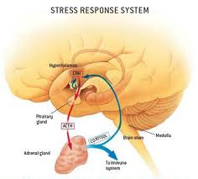
Impact of Religion/Spirituality on Health
Lower levels of stress hormones
Better equipped to cope with the challenges in life
Able to modulate your reactions and your emotions to believe there is a broader purpose
Notes:
Managing stress is a key factor in good health. Religion and spiritual life tend to reduce stress loads.

Slide 22
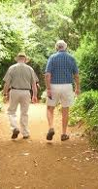
Longevity and
Loma Linda
There are many reasons what this Blue Zone exists. We can learn much by practicing the lifestyle habits that they have adopted.

Slide 23
Loma Linda - Review
How do their religious beliefs permeate multiple powers of 9? Give specific examples
How do the residents of Loma Linda control their environment to support existing healthy behaviors? Provide multiple examples.
Explain how spirituality can impact mental and emotional health.
What strategies utilized in this Blue Zone, can you use to help you achieve your “Power Goals”?
Notes:
These are important review questions

